Slide 1

SKSVMACET,Laxmeshwar
Sensor Data Distribution On Cricket Ground
Submitted By:
Vikas.Savadi
Swaroop S.B

Slide 2
Overview
Introduction
Related Work
Proposed System
Comparison With existing system
Conclusion & Future Work

Slide 3
Introduction
Liking and disliking when it is the matter of National sports things get more sensitive and touchy.
Wrong decisions at the time of a climax leading to ultimate disappointment and a state of disparity for its fans
Spoil of matches due to Umpire’s simple carelessness
Support of number of coaching activities by computer science
1. strategy development
2. performance evaluation

Slide 4
Introduction
Combination of quantitative statistics with qualitative video analysis by semi-automatic observational systems.
Problems addressed :
A. No Ball Decision
B. Fielders in the Ring in First 15 Overs
C. Leg before Wicket Decision (Trajectory Calculation)
Useful information extracted by system:
• Bowling Speed
• Fielding Analysis
• Striking Analysis
• Strike Power etc.

Slide 5
Related Work
M.Beetz : Football Interaction and Process Model
Hey & Scott Carter : Memory Tennis(Enchanced table tennis practical table)
A. G. Foina :RFID technology connected to 3-layer software
Zoe Drey and Charles Consel :Pantagruel-a visual programming language which is end user oriented
Ed H. Chi : propelled ubiquitous computing into the extremely hostile environment
Ramy Asselin : design and evaluation of proposed system called Personal Wellness Coach System (PWC).

Slide 6
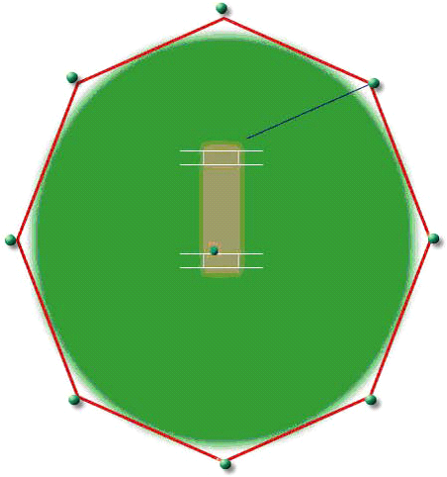
Proposed System
Focus on finding the location of ball during the game at any instant
Placement of sensors at various hotspots in the playground,cricket ball and in the shoes of Player.
Collection of data, formatting it for storage and Store it for future use.
Process of data received from sensors placed in moving objects.

Slide 7
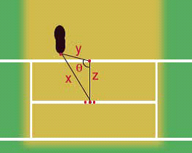


Proposed System
No Ball Decision :
Triangular placement of sensors
Distance Formula
Cosine Formula

Slide 8
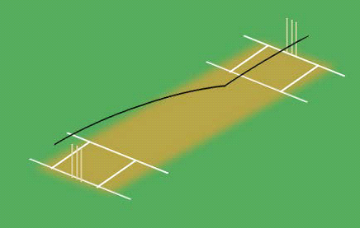
Proposed System
Leg-Before Wicket Decision(Trajectory Calculation) :
Use of Hawk eye Camera along with other image processing and computer vision cameras
Use of special sensors that receives information from moving ball every 100th of second
Calculation of parabolic curve of ball traveling across the wicket

Slide 9
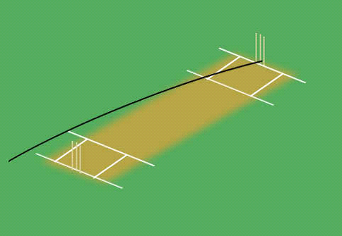
Proposed System
Game Analysis:
Analysis of players during game monitoring their movements
Setting up of strategic plan and bowling analysis
Graphs of strike rate, strike power determination

Slide 10
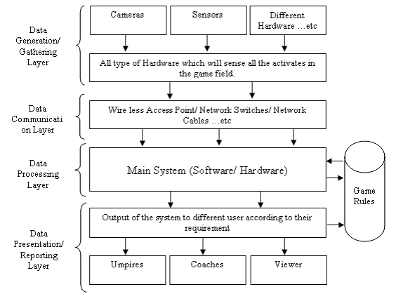
Proposed System
Data Generation/ Data Gathering Layer
Data Communication Layer
Data Processing Layer
Data Presentation/
reporting Layer:

Slide 11
Comparison with existing system
Use of record videos by third umpire
Hardware like speed calculation camera
factors like wind speed , wind direction, humidity in air , pitch condition , ball condition

Slide 12
Conclusion
work in progress of a tool designed to help game umpires
An indoor location tracking system for pervasive and sensor-based computing
Implementation of systems for tracking activities of outdoor games
future challenges include tracking the ball in real-time, sensing the no ball

Slide 13
Thank you

